Slide 1
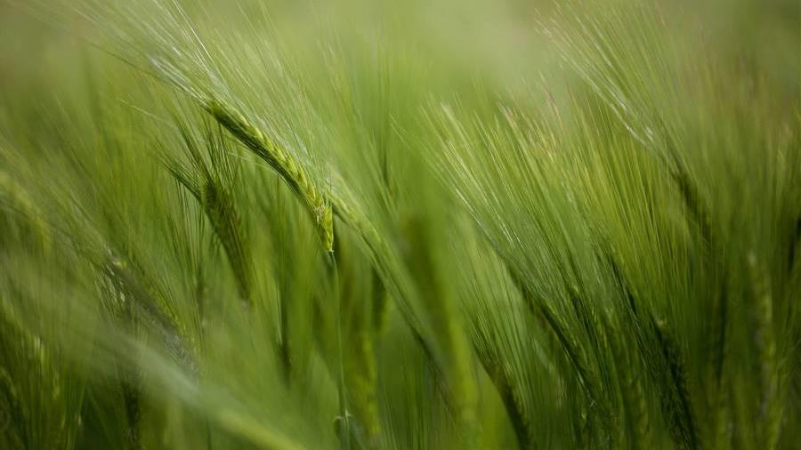
T-800 Mary’s Toys
Michaela & Nicolas

Slide 2
Sprint 1
References and Style
About us
One of the first things that needed to be completed was to reference both our stylesheets and script, as well as, create a professional layout.
With small business, adding an about us pages was vital.
Personalized
Added quotes and background that fit thematically with Mary’s toys product selection.
Copywrite
Getting the footer and making sure the copyright mark was included.

Slide 3
Demo

Slide 4

Conclusion
References and Style
Copywrite
Personalized
About us

Slide 5

Questions?

